Slide 1

Introduction to Jenkins Continuous Deployment Pipeline

Slide 2


Slide 3
Why Jenkins?
Multiple Service Integrations
Customization
Full Control of Deployment
Detailed Build Reporting
Notes:
Multiple Service Integrations
There are many available built in plugins for various version control programs, container orchestration programs
Dockerhub, Kubernetes,
Customization
All parts of the build process can be customized,
Full Control of Deployment
All aspects of the deployment process can be configured
Detailed Build Reporting

Slide 4
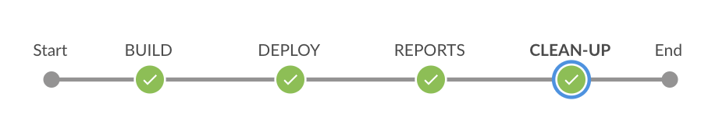
Continuous Deployment Pipeline
Triggered by commit or manually
Container Clean up
Tests or build reports
Notes:
Continuous Deployment

Slide 5
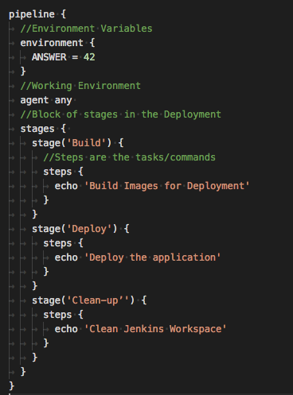
What is a JenkinsFile?
A build configuration file, that defines steps in the Jenkins Deployment Process.

Slide 6
Useful Links
https://www.linode.com/docs/development/ci/automate-builds-with-jenkins-on-ubuntu/
https://medium.com/@gustavo.guss/jenkins-starting-with-pipeline-doing-a-node-js-test-72c6057b67d4
https://medium.com/@weblab_tech/how-to-publish-artifacts-in-jenkins-f021b17fde71
https://jenkins.io/doc

